Slide 1
34a – Clean Code – Bridge and Chain of Responsibility and Interpreter
Based on the CleanCoders videos by Uncle Bob Martin
Rupert Waldron

Slide 2
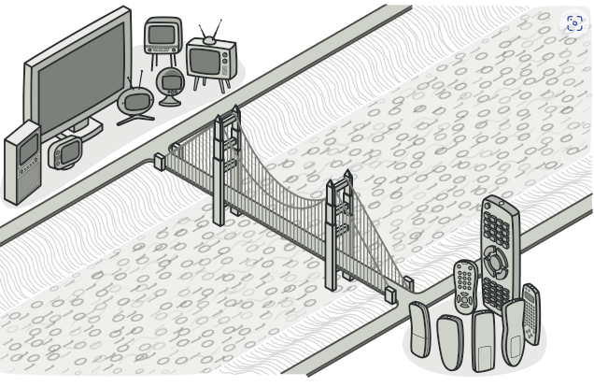
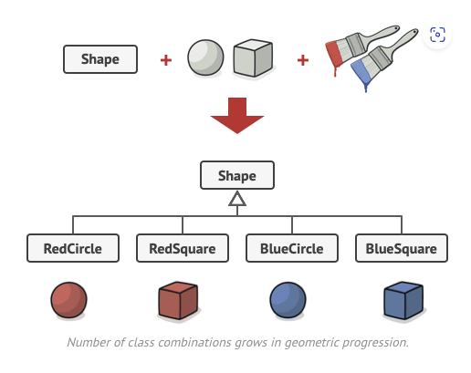
Bridge Pattern
The Bridge pattern is used to decouple an abstraction from an implementation

Slide 3
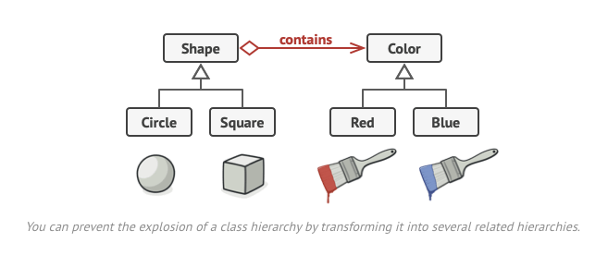
Bridge Pattern
Switch from inheritance to composition
The number of derivatives is the product of the number of degrees of freedom: MxN problem.
To solve this we use the Bridge Pattern (looks like a load of strategy patterns and violates Tell Don’t Ask principle

Slide 4
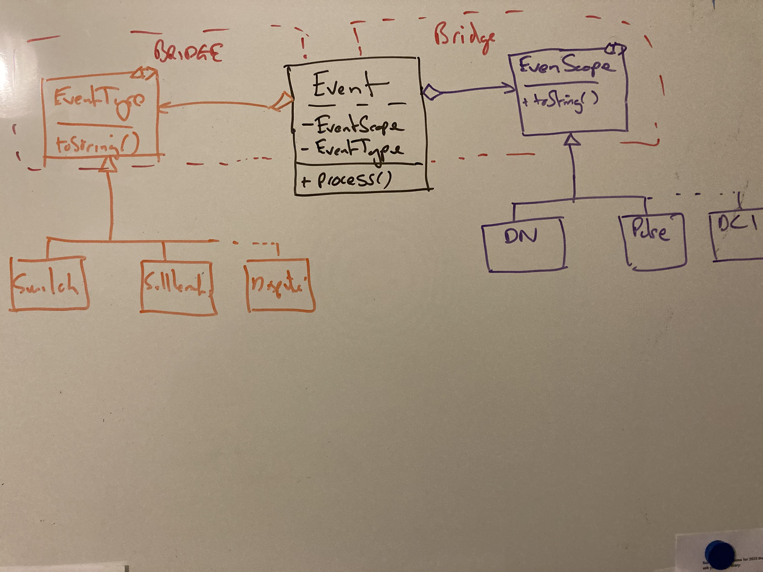
Bridge Pattern – Discover Example
An MxN problem now has become a M + N problem.
EventType and EventScope can now be developed independently

Slide 5
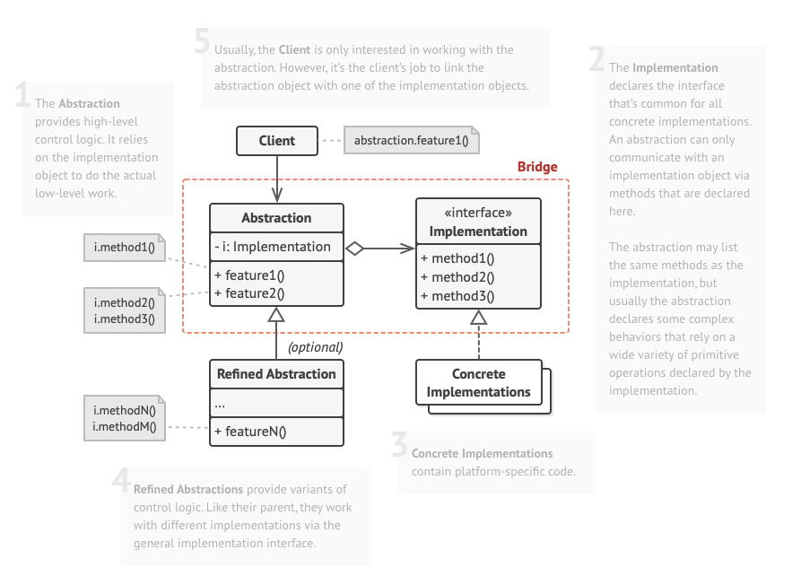
Bridge Pattern

Slide 6
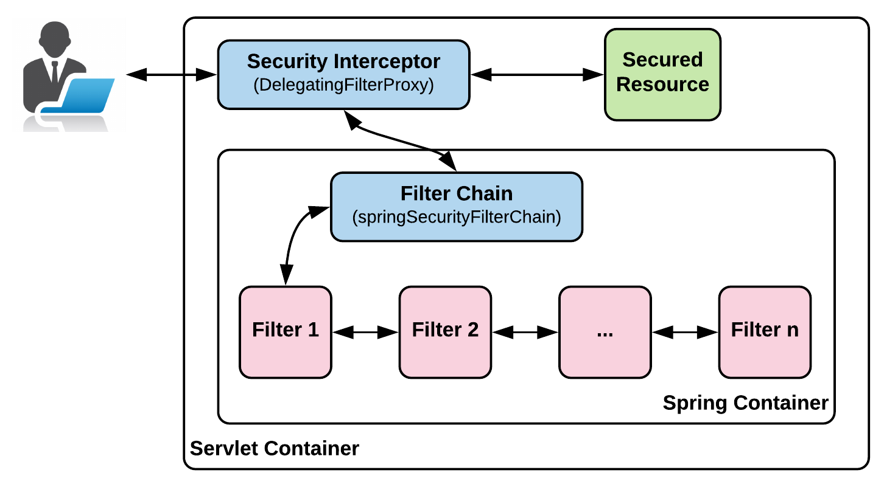
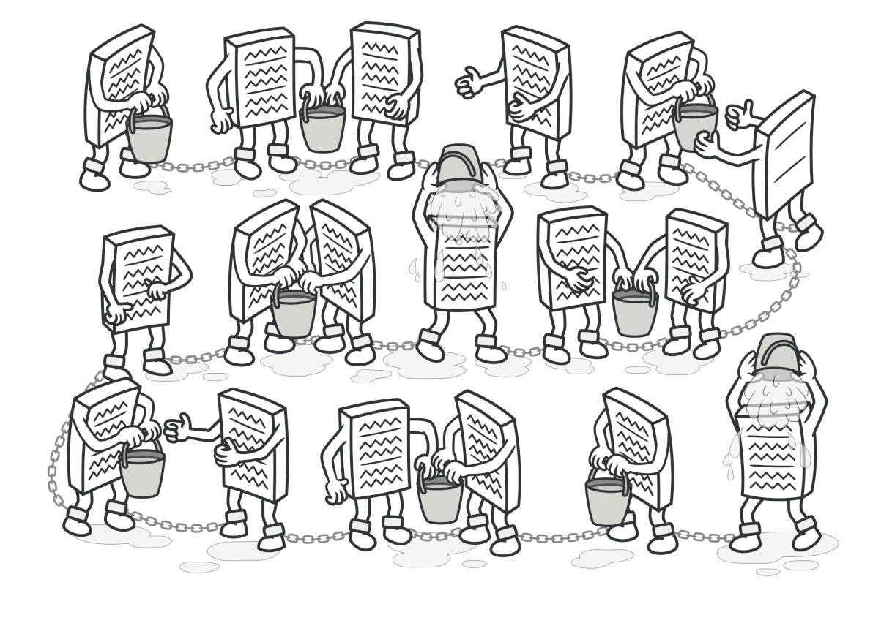
Chain of Responsibility Pattern
Avoid coupling the sender of a request to its receiver by giving more than one object a chance to handle the request.
Spring security is a good example of the use of this pattern

Slide 7
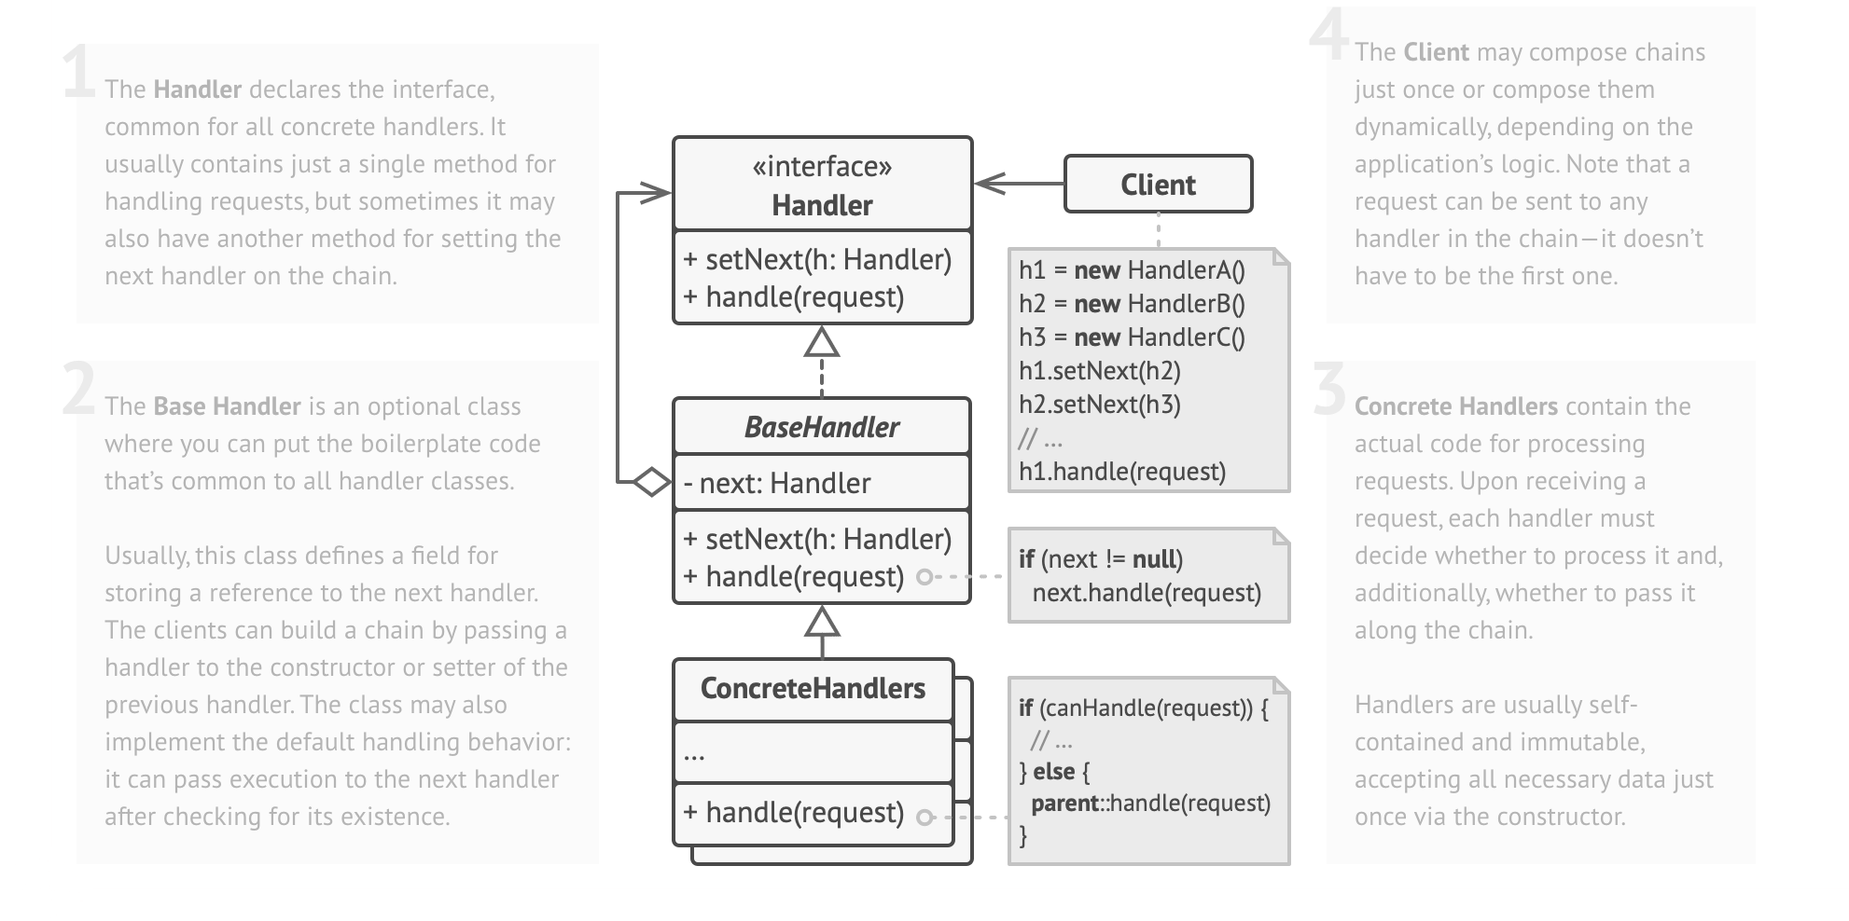
Chain of Responsibility Pattern
See the code – processing of events

Slide 8
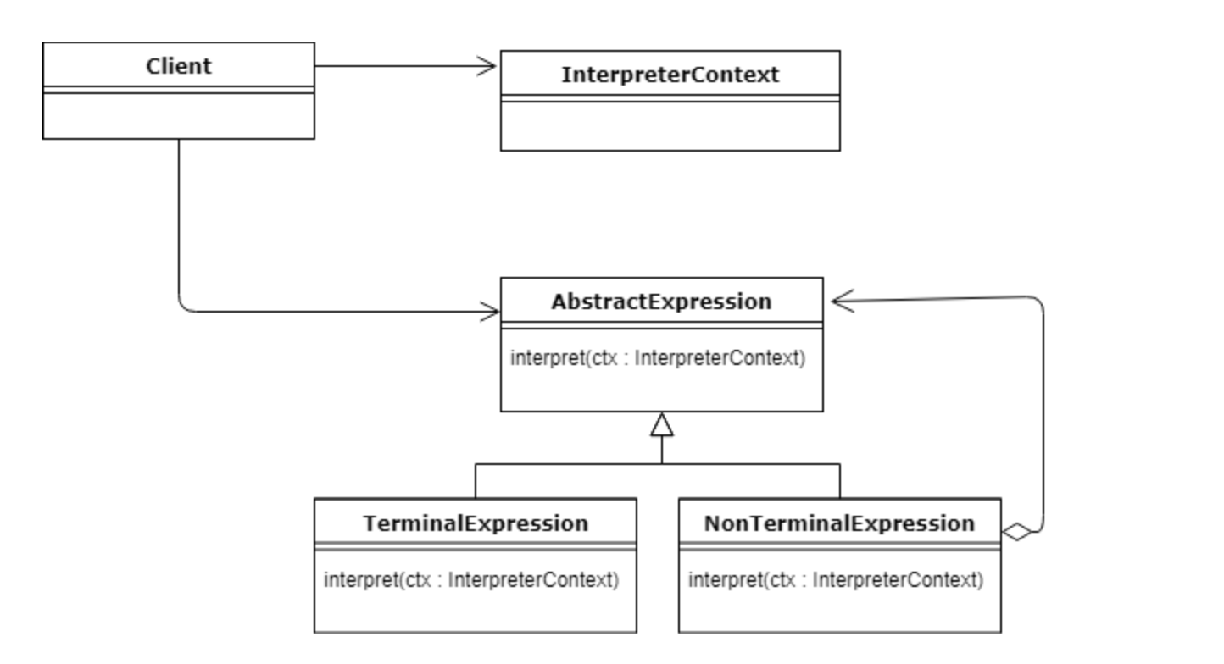
Interpreter Pattern
When your design there is so much coupling in your program you need to event a whole new language (dsl) to deal with it you are skating very close to the edge of over engineering
It is a good way to externalize some functionality that would otherwise have to be included in the code. E.g. SQL
The context is basically the runtime environment and includes all state and variables

Slide 9
Interpreter Pattern - Calculator
When your design there is so much coupling in your program you need to event a whole new language (dsl) to deal with it you are skating very close to the edge of over engineering
We will use Reverse Polish Notation because that is easy to parse using a stack
We will use Reverse Polish Notation because that is easy to parse using a stack:
3 5 + // 8
2 9 5 + - // 12
See the code…

